Slide 1
Machine Learning Project
Case Study on IPL DataSet (2008-2019)

Slide 2
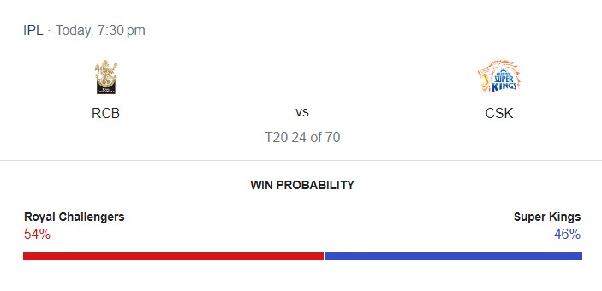
Introduction

Slide 3
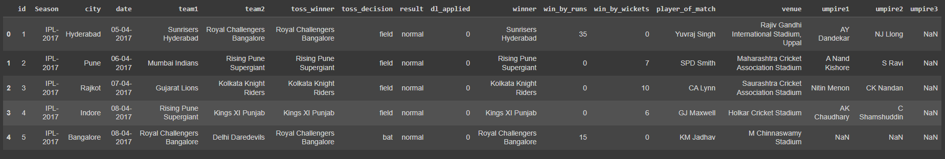
Understanding The Dataset

Slide 4
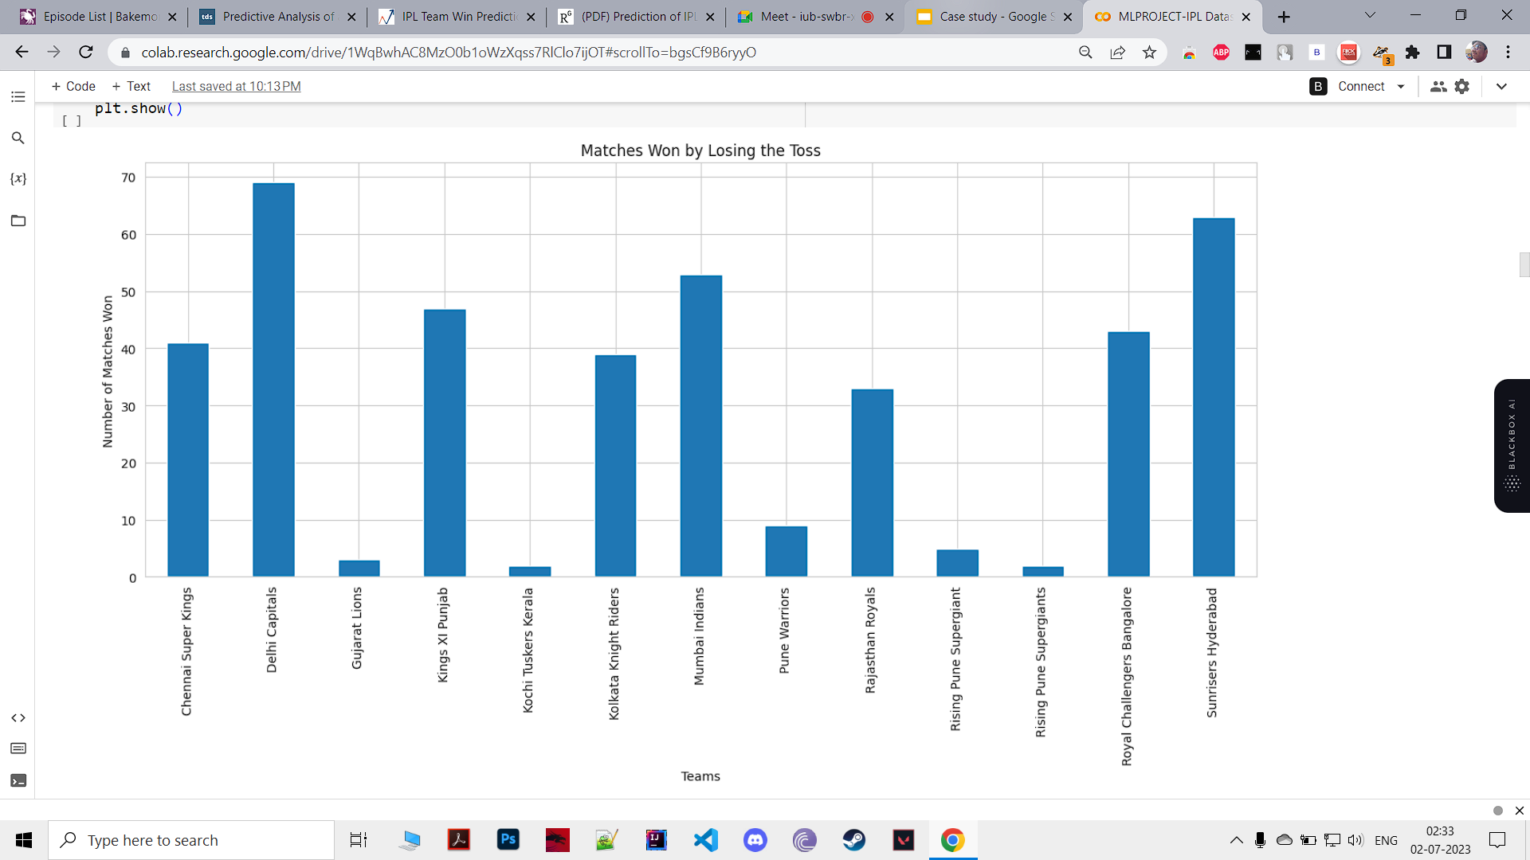
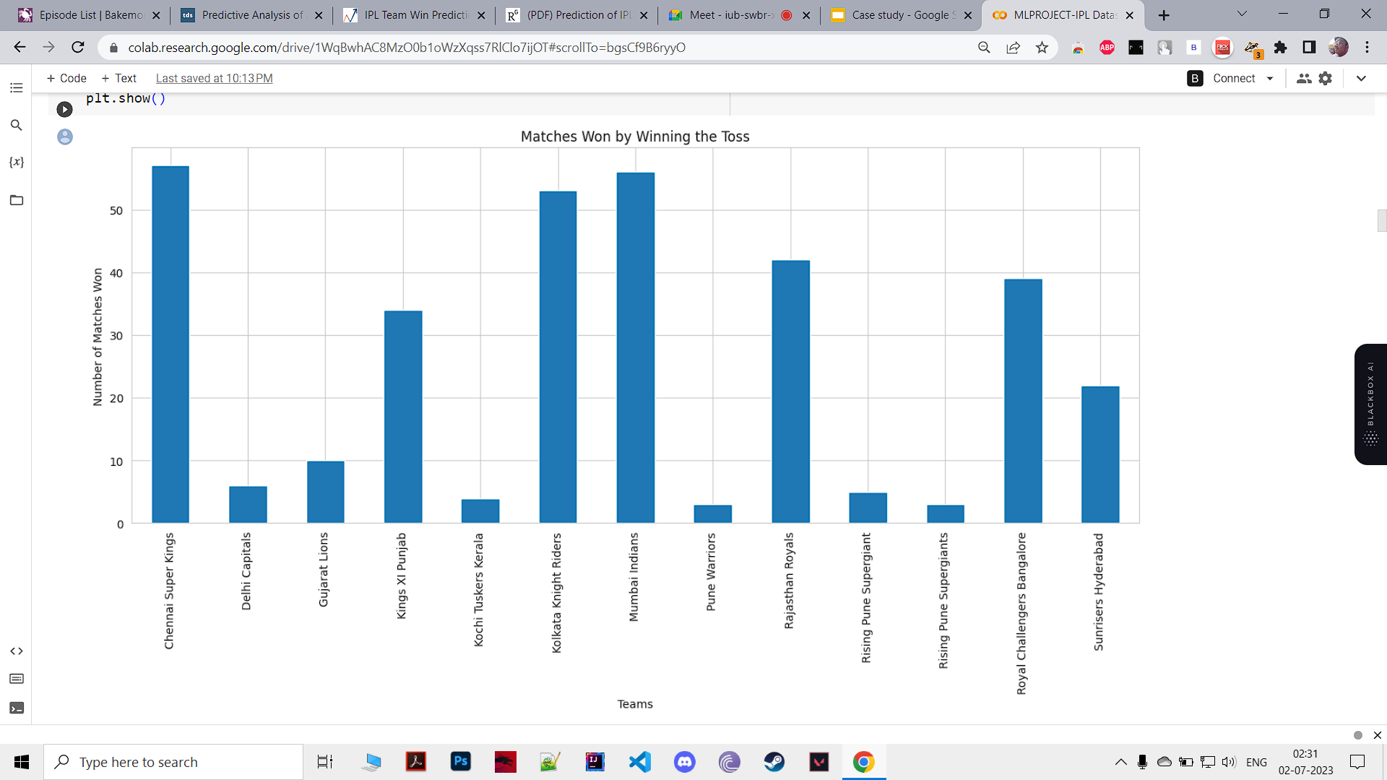
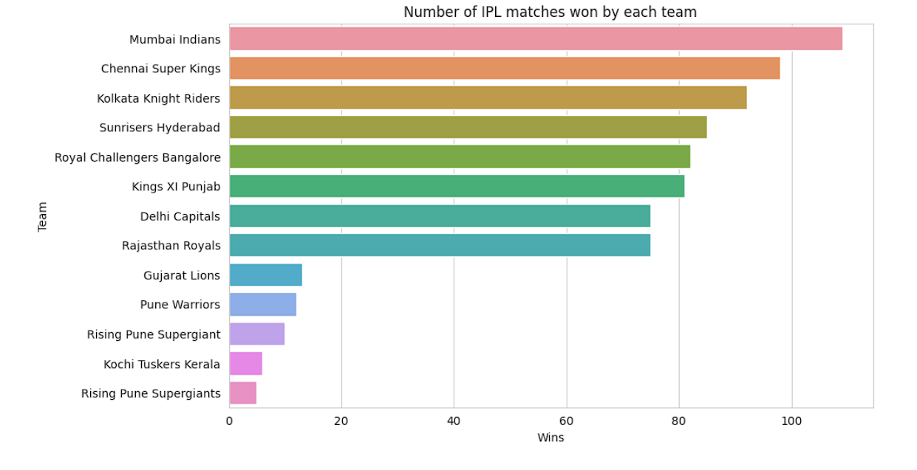
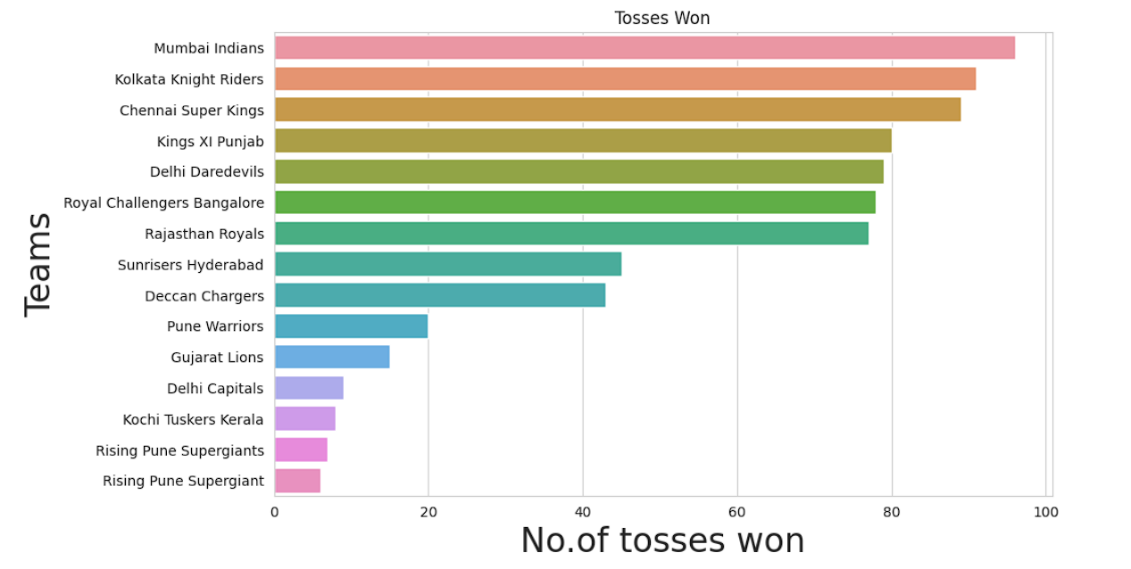
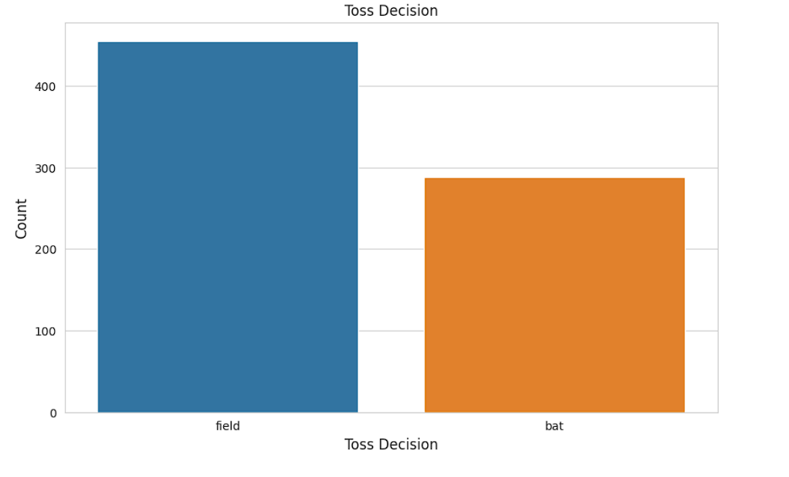
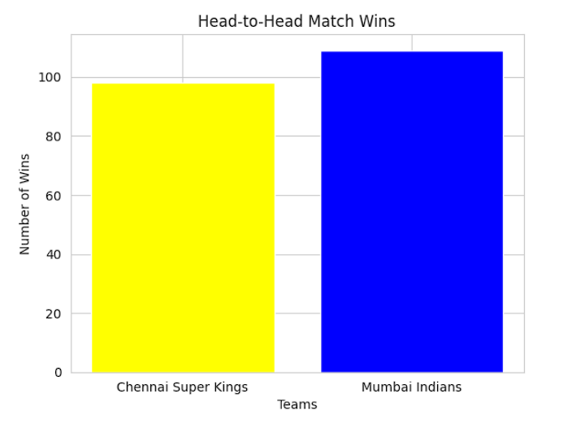
Visualizing and Analyzing The Data

Slide 5
Defining the problem
Given IPL dataset of past 9 years, the main objective is to predict the outcome of an IPL match between two teams based on the analysis of previously stored data using Machine Learning algorithms.

Slide 6
Processing the data as per the problem’s requirements
Cleaning the data.
Splitting the data into independent and dependent variables
Setting dummy variables for training.
Converting categorical values into numericals using Label Encoder.
Splitting the data for training and testing

Slide 7
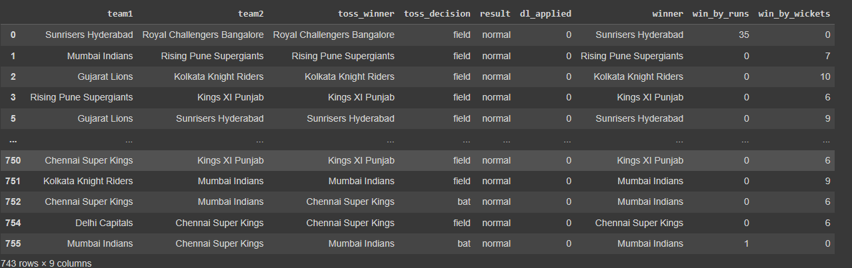
Cleaning the data
Removing null values.
Removing anomalies.
Removing Unnecessary data.

Slide 8
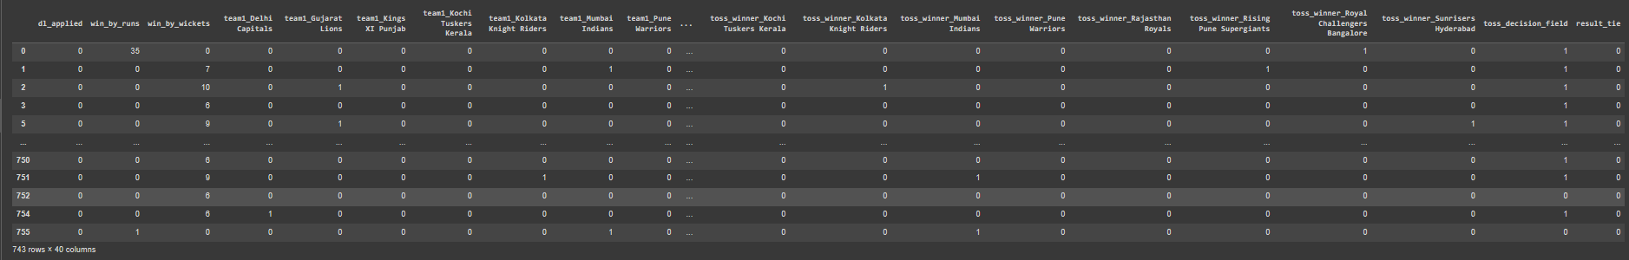
Setting Dummy Variables For Training

Slide 9
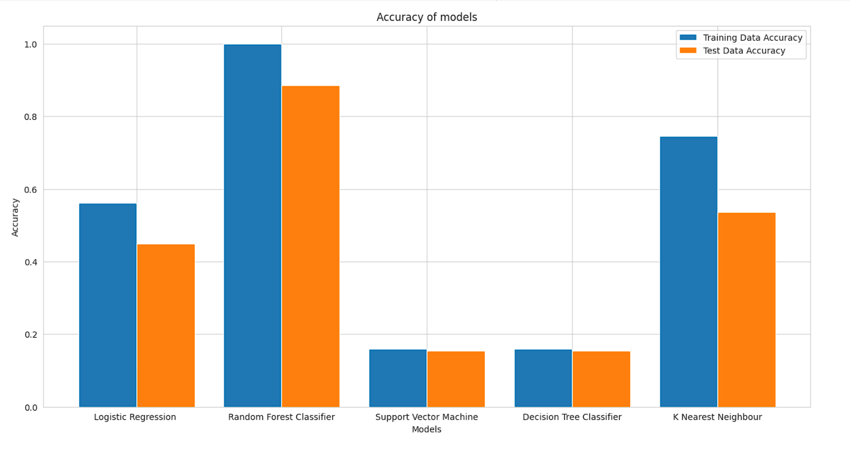
Model Creation and Evaluation

Slide 10
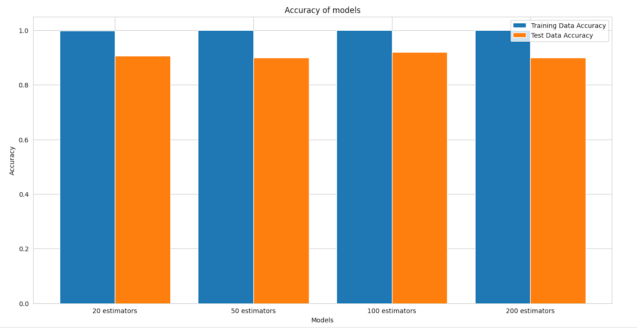
Selecting and fine-tuning the model

Slide 11
THANK YOU!

